Slide 1

Finding Critical and Pseudo-Critical Edges in Minimum Spanning Tree
Overview
Project by :
Student Name: CH. Chandra Naga Sai Kumar
Course Code: CSA0656
Course Name: DAA
Slot: A

Slide 2
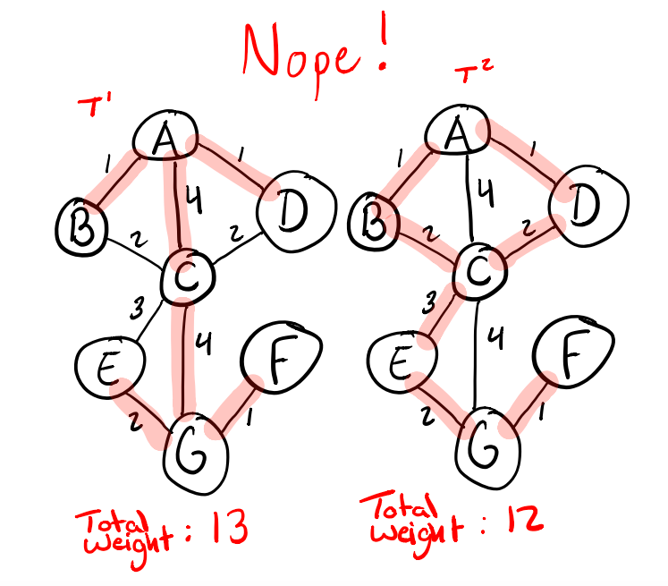
Abstract
The goal is to identify critical and pseudo-critical edges in a Minimum Spanning Tree (MST) of a weighted, undirected, and connected graph.
A graph is defined by 'n' vertices and an array of edges, where each edge is represented as an array of three values: [vertex1, vertex2, weight].
Critical edges are those that, if removed, will increase the total weight of the MST, while pseudo-critical edges can appear in some MSTs but not all.
This classification is essential for optimizing network design, ensuring the most efficient connections while minimizing costs.

Slide 3
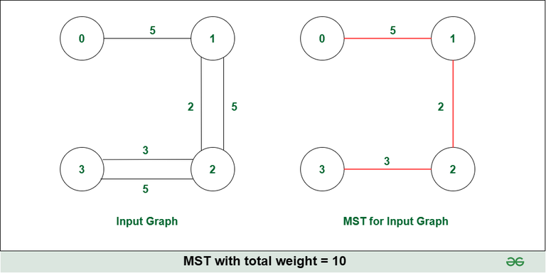
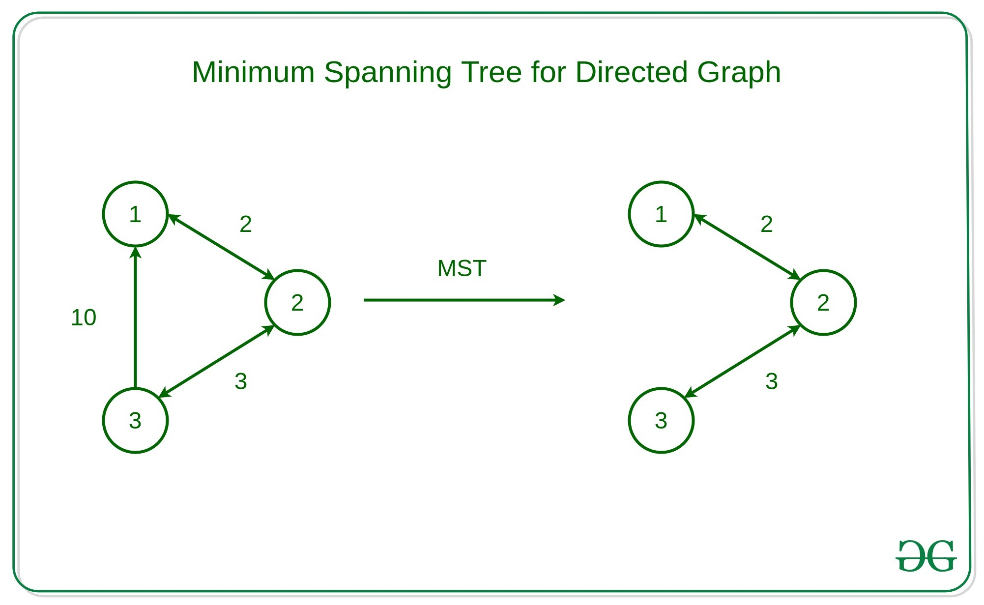
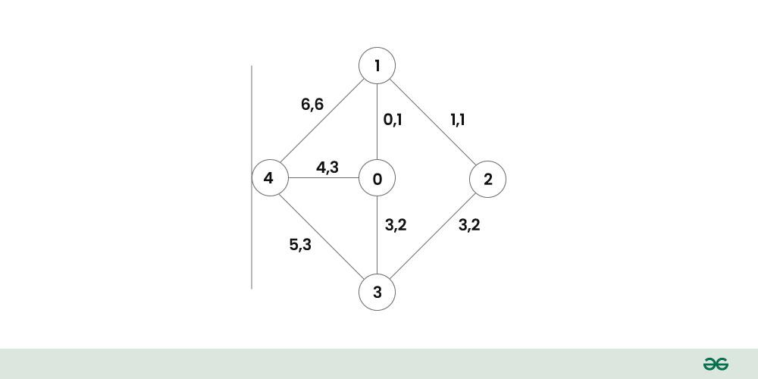


problem
Example
Input Details
Output Interpretation
Understanding Edge Types
Given a graph with n = 5 vertices and edges as follows: [[0,1,1], [1,2,1], [2,3,2], [0,3,2], [0,4,3], [3,4,3], [1,4,6]].
Output: [[0, 1], [2, 3, 4, 5]]. Critical edges are [0,1] and [1,2] as they appear in all MSTs.
Critical edges are essential for every MST, while pseudo-critical edges may appear in some but not all MSTs.

Slide 4
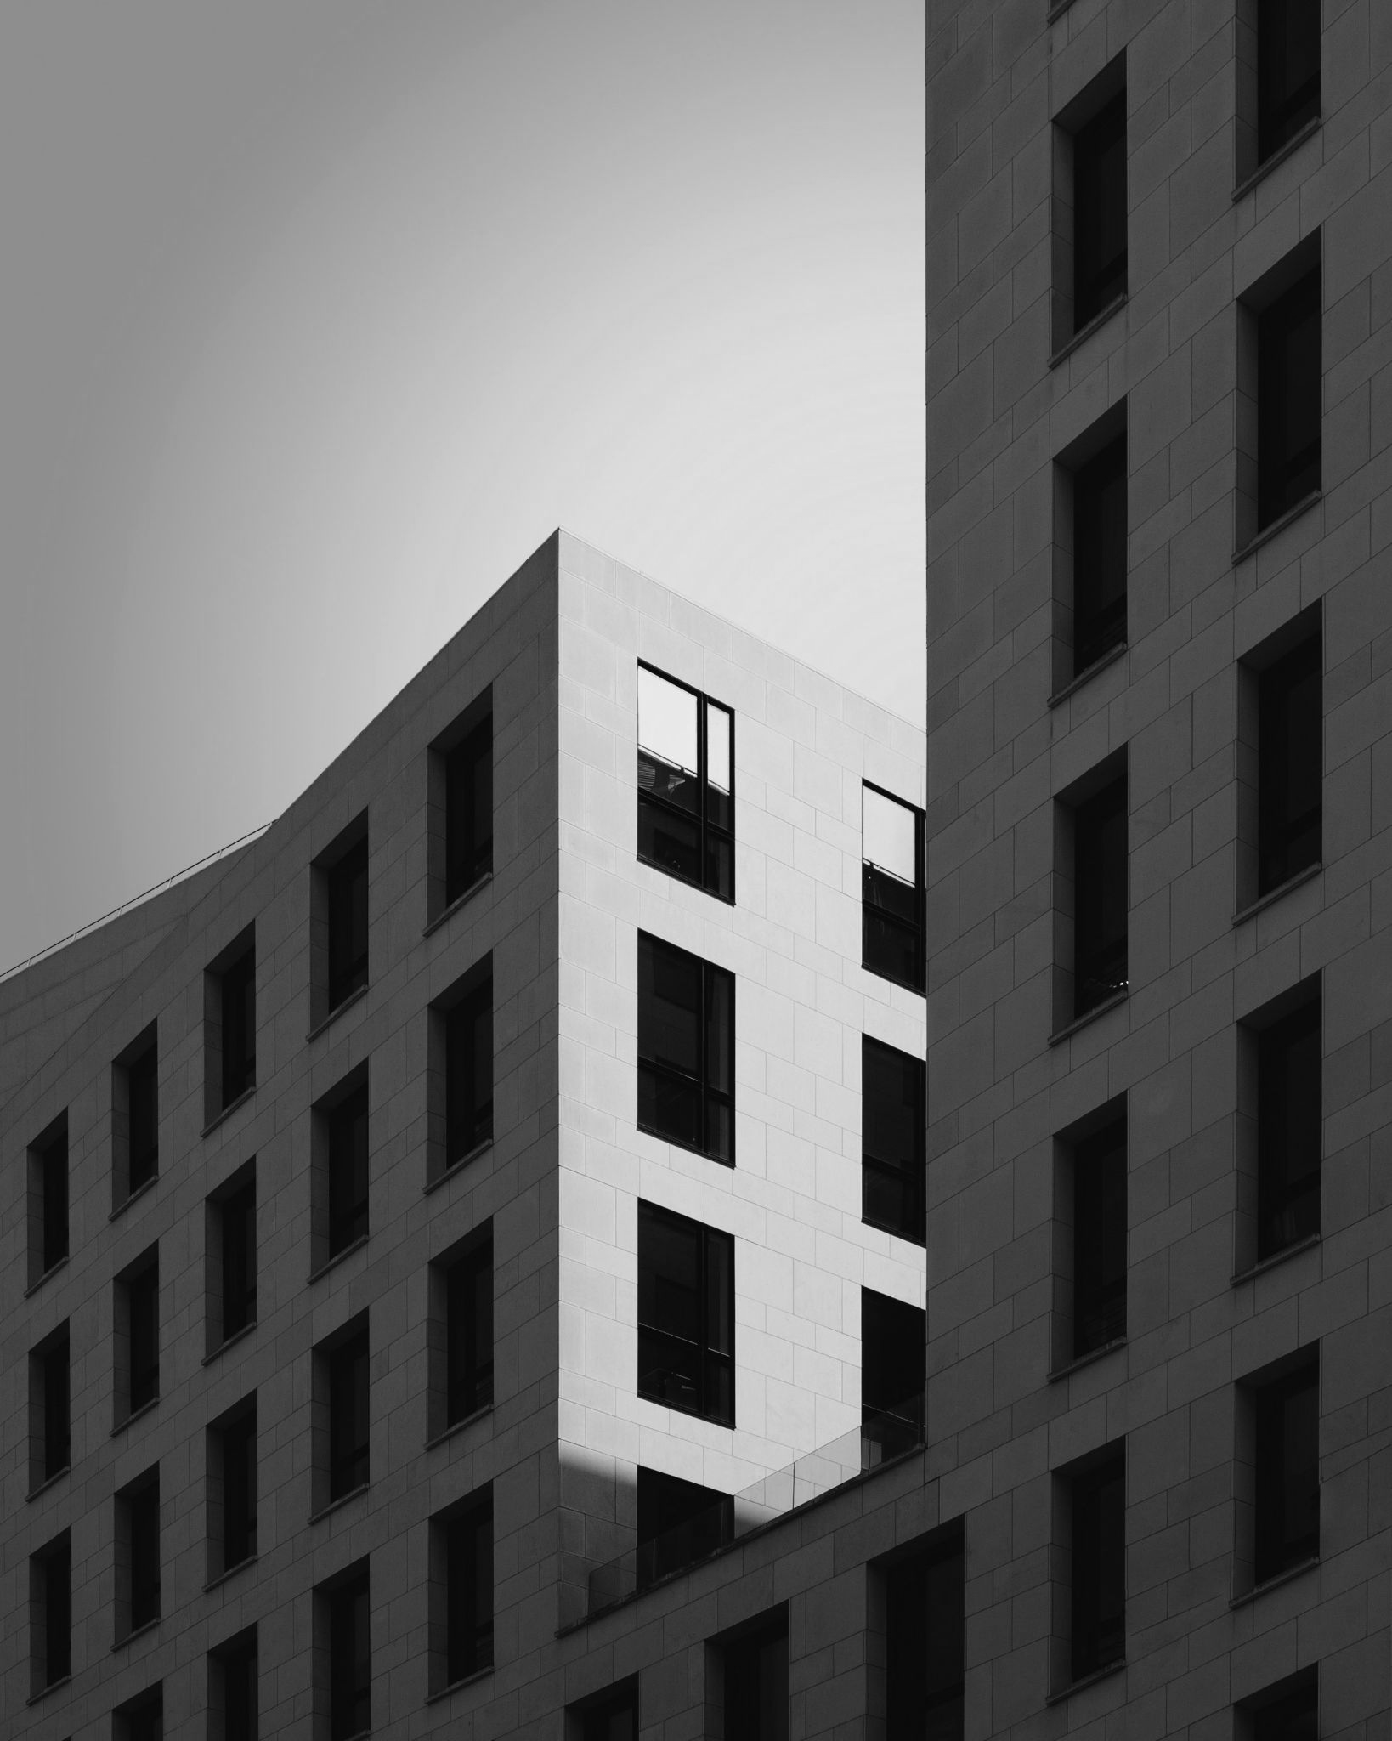
Initial Inefficient Approach
Compute the MST using all edges initially.
For each edge, check if its removal increases the MST weight.
For each edge, check if forcing its inclusion maintains the same MST weight.
Efficient Approach Using MST
Utilize Kruskal's or Prim's algorithm to compute the initial MST.
For each edge, remove it and check if the MST weight increases for critical edges.
For pseudo-critical edges, include each edge and check if the MST weight remains unchanged.

Slide 5
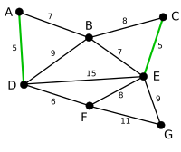
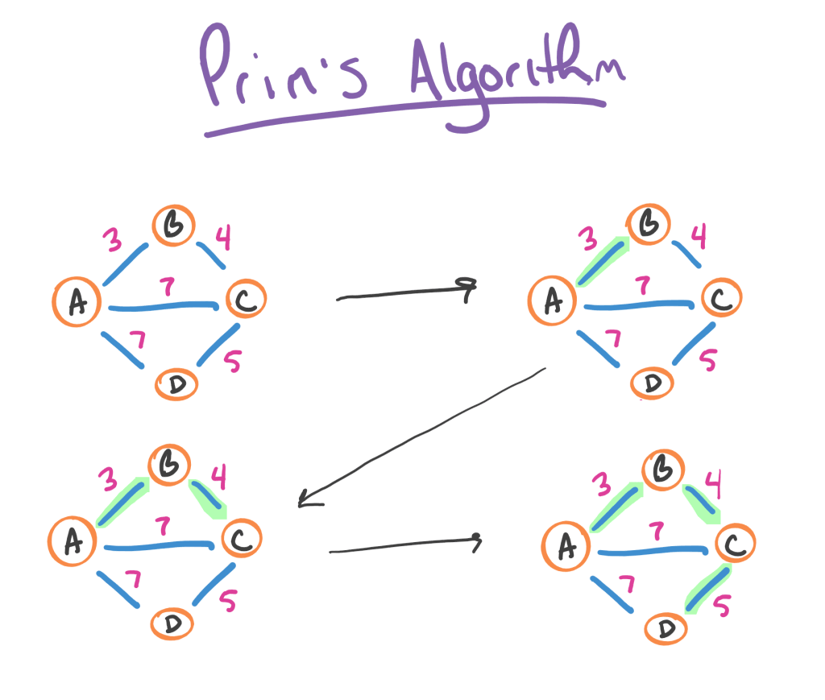
MST Techniques
Algorithms
Kruskal's Algorithm
Sort edges by weight, then add edges to the MST using a union-find structure while avoiding cycles, stopping when n-1 edges are included.
Prim's Algorithm
Start from an arbitrary vertex and continuously add the minimum weight edge connecting the tree to a new vertex until all vertices are included.

Slide 6
Detailed Steps
MST Techniques
Compute MST Weight
Identify Critical Edges
Identify Pseudo-Critical Edges
Final Classification
Use Kruskal's algorithm to find the MST. Sort edges by weight, add edges without forming cycles until n-1 edges are included. Record the total weight as a baseline.
Remove each edge one at a time and recompute the MST weight. If the new weight exceeds the original, classify the edge as critical, meaning its removal increases the MST weight.
Force the inclusion of each edge and recompute the MST weight. If the weight remains the same as the original, classify the edge as pseudo-critical, indicating it can appear in some MSTs.
Compile the results from the previous steps to create a comprehensive list of critical and pseudo-critical edges. This classification aids in understanding the graph's structure.
Total MST Weight
List of Critical Edges
List of Pseudo-Critical Edges
Final Lists of Critical & Pseudo-Critical Edges

Slide 7

Complexity Analysis
Analysis
Best Case Complexity
Worst Case Complexity
Average Case Complexity
In the best case, sorting edges and initial MST calculation require O(E log E) + O(E log V). If early edges form a complete MST, checks for critical or pseudo-critical edges can be minimized.
In the worst case, the complexity is O(E log E) for sorting and O(E log V) for MST calculations. Each edge may need two full Kruskal's algorithm runs, leading to O(E^2 log V).
On average, the complexity combines best and worst scenarios, approximated as O(E log E) + O(E^2 log V). The dominant term is O(E^2 log V), assuming a moderate number of vertices and edges.

Slide 8

Conclusion
The project successfully identified critical and pseudo-critical edges in the Minimum Spanning Tree (MST) of a weighted, undirected graph using efficient algorithms.
Kruskal's algorithm, combined with a Union-Find data structure, allowed for efficient calculations of MSTs and edge classifications.
Critical edges are those that must be included in all MSTs, while pseudo-critical edges may appear in some but not necessarily all MSTs, allowing for flexibility in edge selection.

Slide 9

Thank you.

